Slide 1
Exostar’s Managed Microsoft 365
Sponsor Admin & Team Manager Training
2026

Slide 2
Course Objectives
Introduction Managed Microsoft 365
General Navigation
Basic Functionality (Exostar application)
Send Files Externally
Reports
Self-Help Overview (MyExostar)
2026

Slide 3
Introduction Exostar’s Managed Microsoft 365
2026

Slide 4

What is Exostar’s Managed Microsoft 365?
Managed Microsoft 365 is managed service that provides a secure, compliant collaboration solution for sharing content focused on the Defense Industrial Base (DIB).
Exostar manages the tenant, security monitoring and compliance to CMMC 2.0 Level 2 (NIST SP 800-171) standards, ensuring secure collaboration, while providing a familiar Microsoft Teams interface.
What are the benefits?
Secures CUI storage
Full managed service
Enforced MFA (regardless identity)
Significantly aids CMMC 2.0 compliance
[85/110 controls]
(NIST SP 800-171)
Delegation of secure sharing to business users
Familiar Microsoft User Experience
2026

Slide 5



Exostar Managed Microsoft 365 Roles
Upload Content
Share Documents
Create Notifications
2026

Slide 6



Roles: Team Manager
Invite members or partners to my team
View reports for my team
Delete Users in my team
*Note: Team Managers also have all Member capabilities.
2026

Slide 7
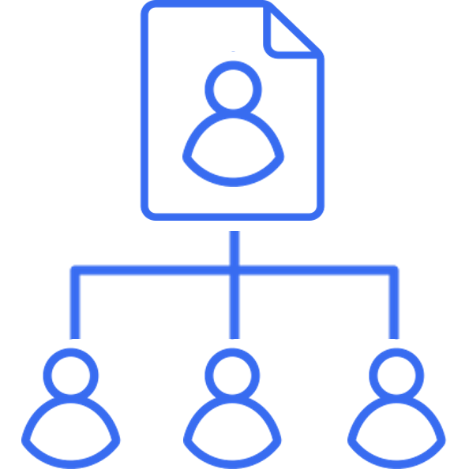

Role: Sponsor Administrator
Create Team
Sites
Add Sponsor
Admins
Assign Team
Members
View Reports (Teams & App Actions)
Note: Sponsor Administrators also have all Team Manager & Member capabilities.
2026

Slide 8
General Navigation
2026

Slide 9
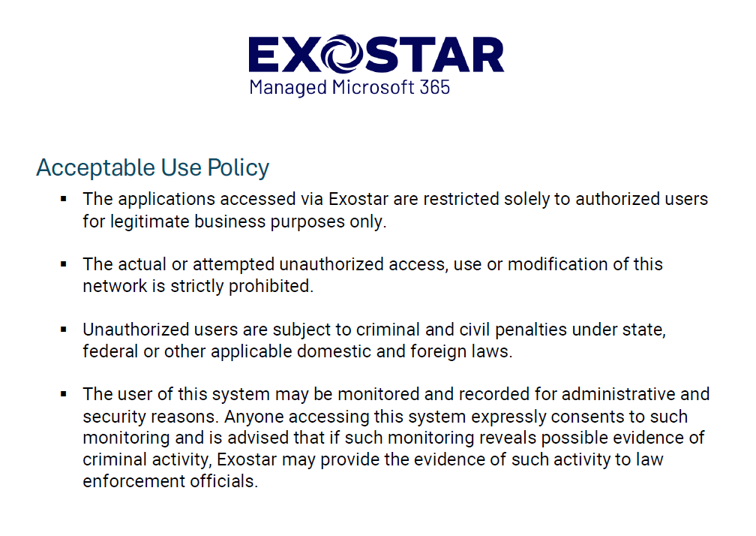
Teams Navigation: MAG Access/Terms of Use
2026

Slide 10
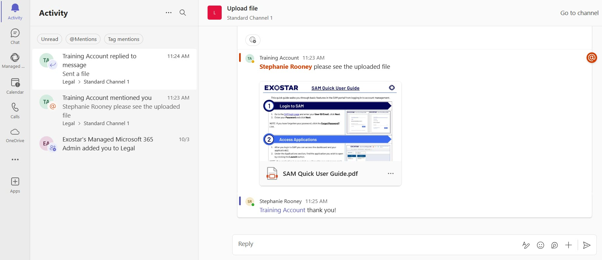

Teams Navigation: Activity tab
1
Activity tab
2
View recent activity
3
Select channel
Enter Reply message
4
Tag/mention a user
2026

Slide 11
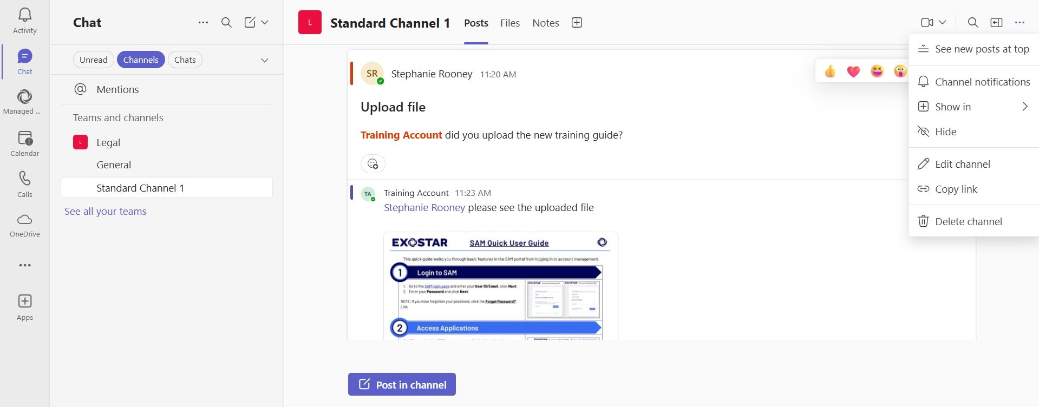
Teams Navigation: Channels / Posts
3
Start a video call
1
Chat tab
2
Posts (all members can see)
4
Channel options; edit channel name
5
Create new Post
2026

Slide 12
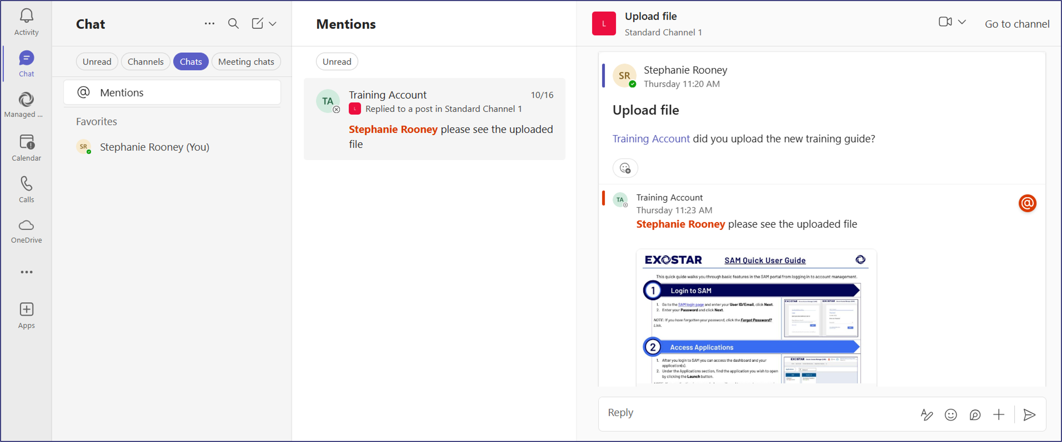
Teams Navigation: Chat
4
Video Call
1
2
Start a new chat
3
View all mentions (@ tags)
Chat tab
Reply to a chat
5
2026

Slide 13
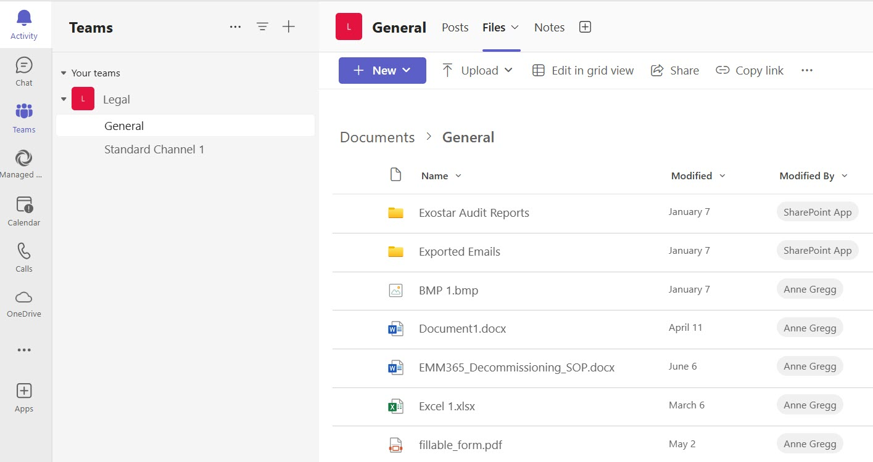
Teams Navigation: Files
Create New Folders, Documents & Upload Files
2
1
Files tab
Channel(s)
3
Displays current Files & Folders within Channel
(store CUI in Managed Microsoft 365)
4
2026

Slide 14
Basic Functions (Exostar Application)
2026

Slide 15
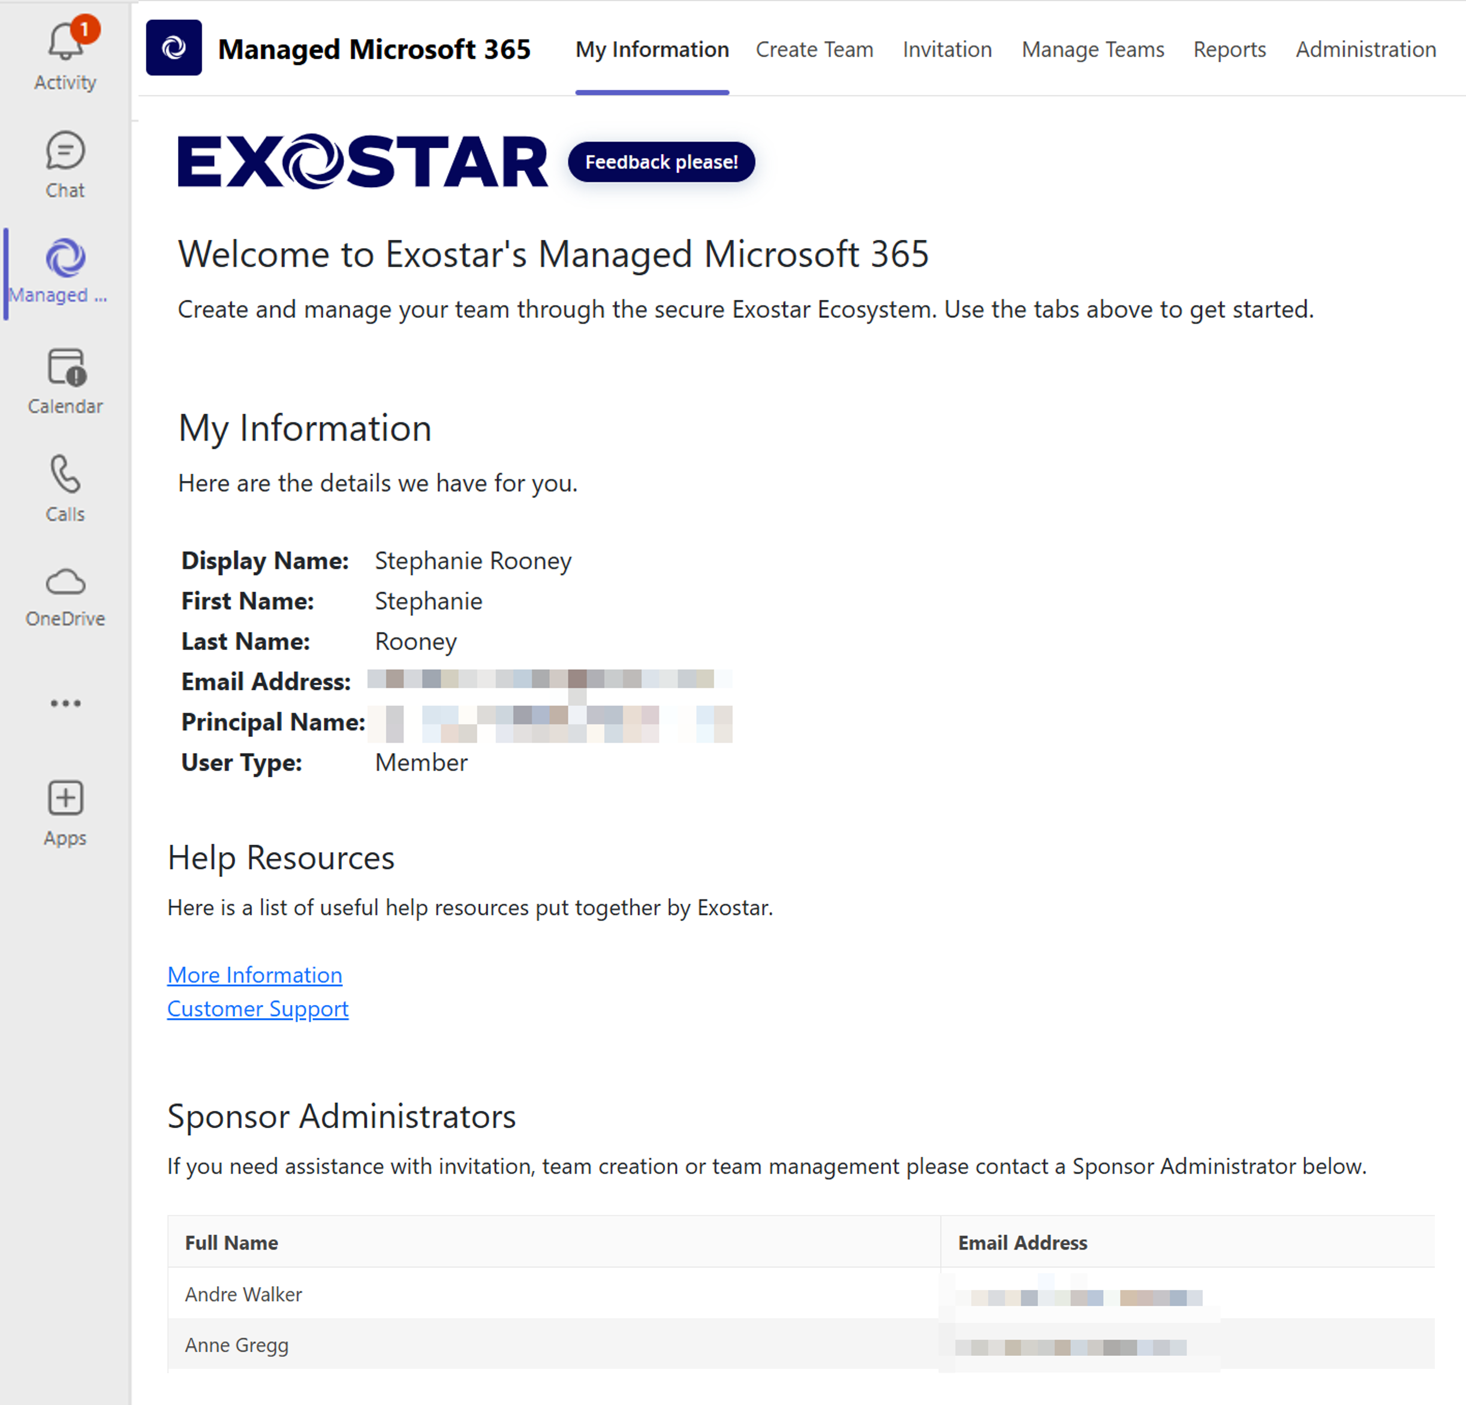
Teams Navigation: My Information
My Information: Displays your user details
1
Help & Resources: Links to training guides and Customer Support
2
Sponsor Admins: Contact if you need a new Teams or invite new Partners
3
2026

Slide 16
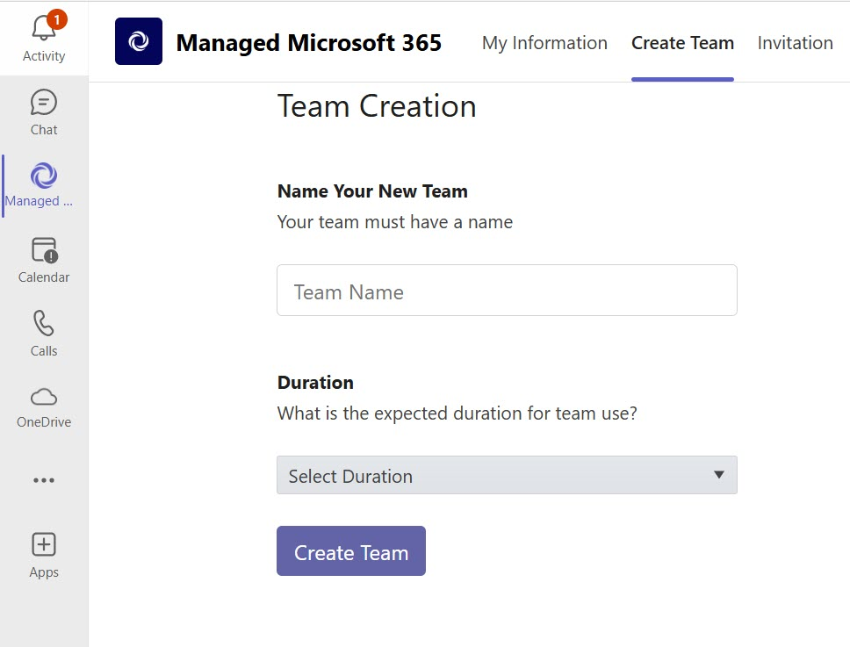
Administration: Create Team
1
Create Team tab
2
Enter Team Name
3
Select Duration
4
Click Create Team button
2026

Slide 17
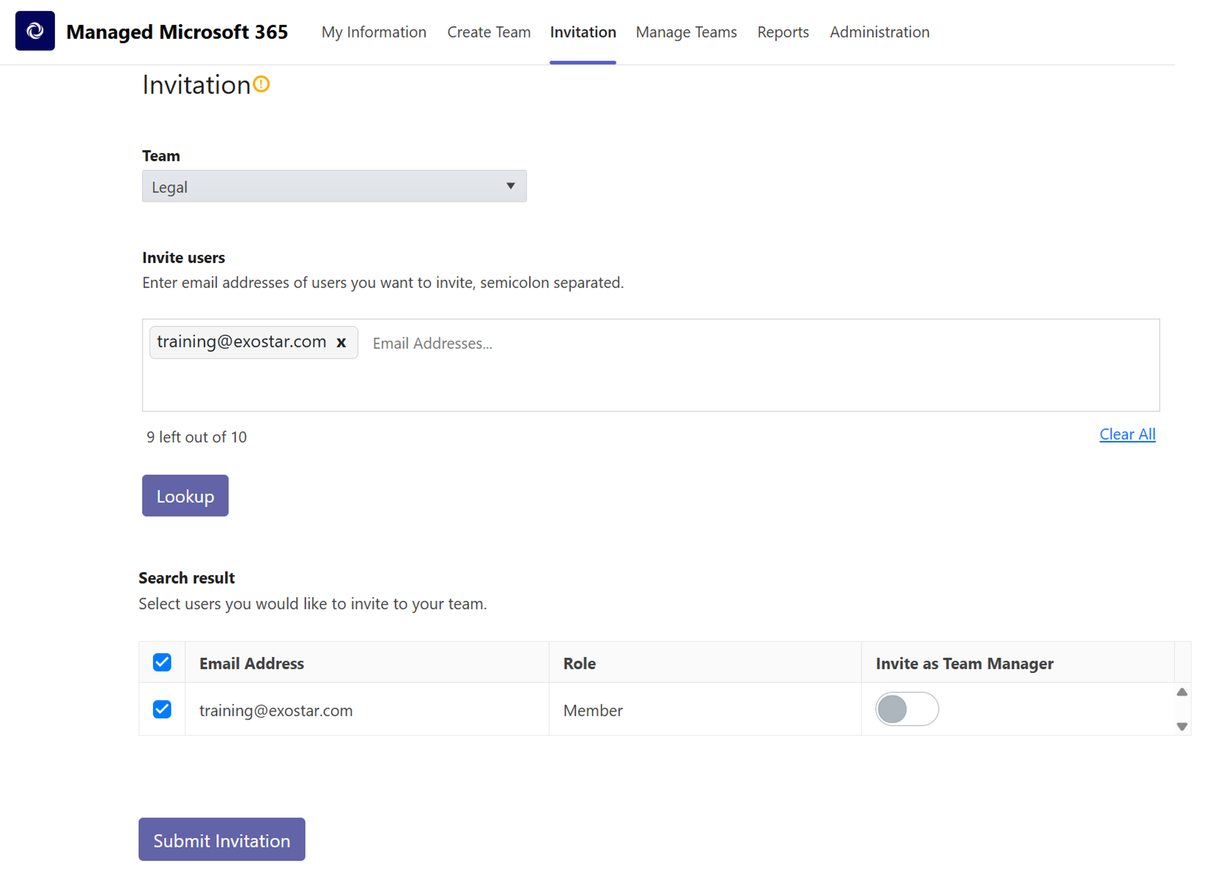
Administration: Invitation tab
Invitation tab
1
Select Team from drop-down
2
Enter User’s email, click Lookup
3
Place checkmark next to user
4
5
Submit Invitation
2026

Slide 18
Administration: Invitation Scenarios
Invitation Status | Description
Domain not Authorized | The user’s domain is not an approved partner domain. User cannot be invited unless a Sponsor Administrator adds the domain to Partner Domains.
Exostar Account Required | Authorized Domain. User can be invited to teams after creating an Exostar account.
Multiple Accounts Found | User has multiple MAG accounts. The system prompts for you to choose which account to invite.
Suspended Exostar Account Found | User was found in Exostar IAM but cannot be invited until the account is reactivated.
2026

Slide 19
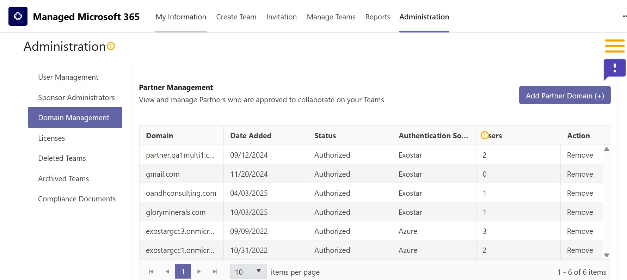
Administration: Domain Management
Domain Management sub-tab
Administration tab
Add Partner Domain
2026

Slide 20
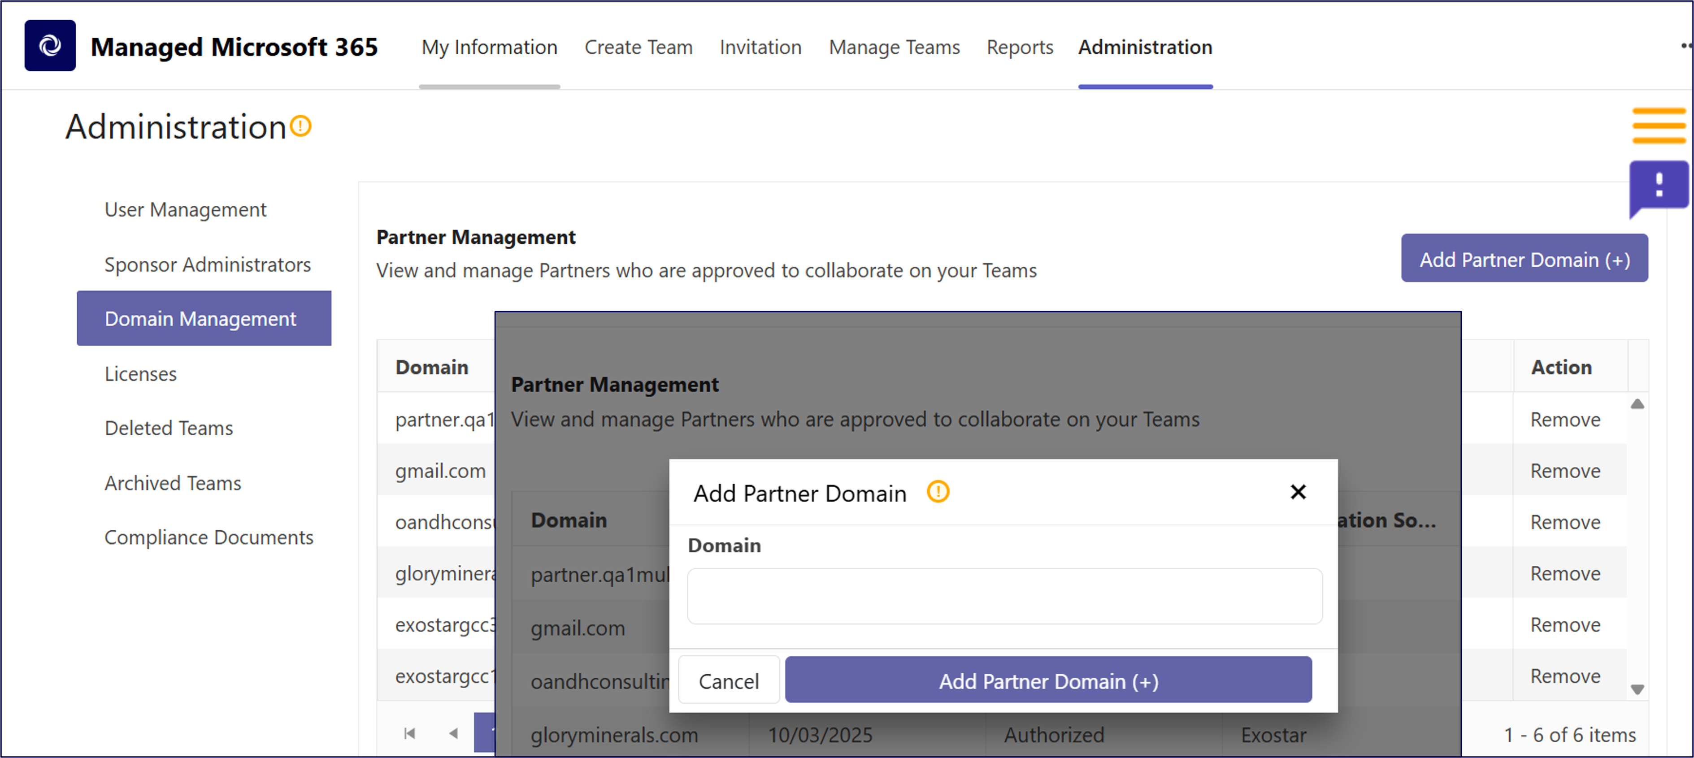
Administration: Domain not Authorized
2
Domain Management sub-tab
1
Administration tab
3
Add Partner Domain
4
Enter Domain name
5
Add Partner Domain
2026

Slide 21
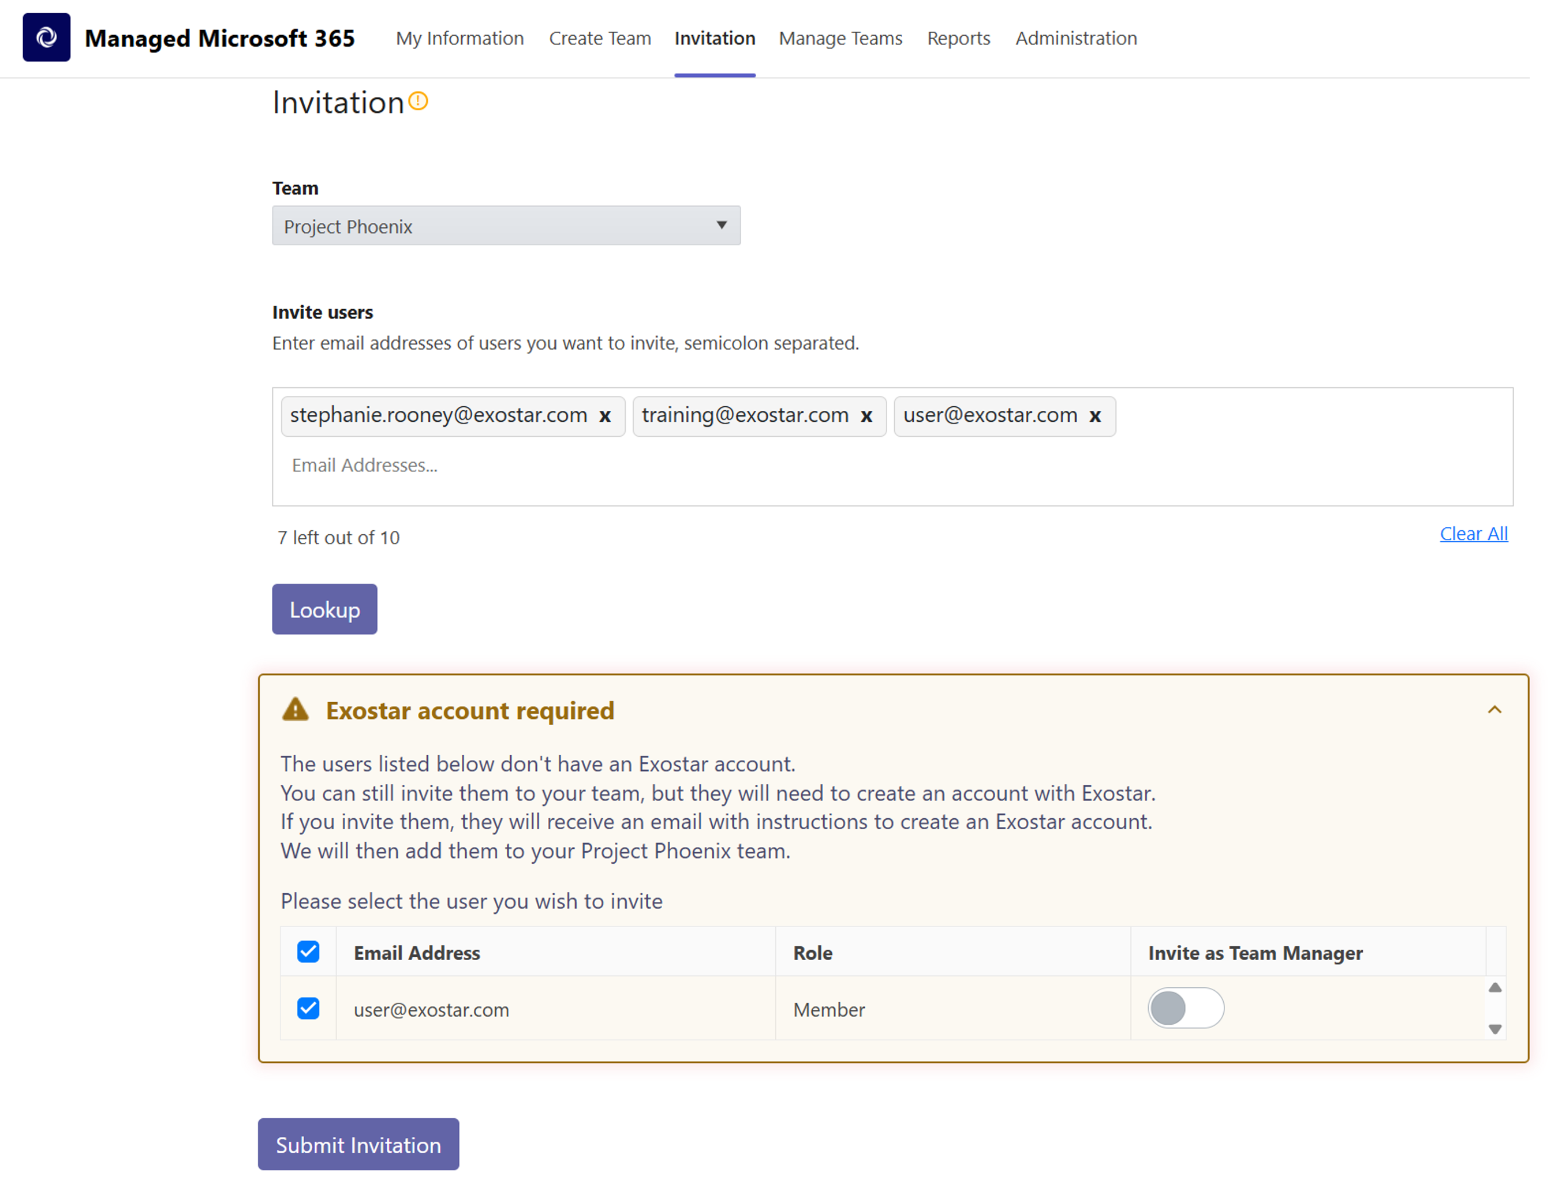
Administration: Exostar Account Required
Invitation tab
1
Select Team from drop-down
2
Enter User’s email
3
Click Lookup
4
Place checkmark next to user
5
Submit Invitation
6
2026

Slide 22
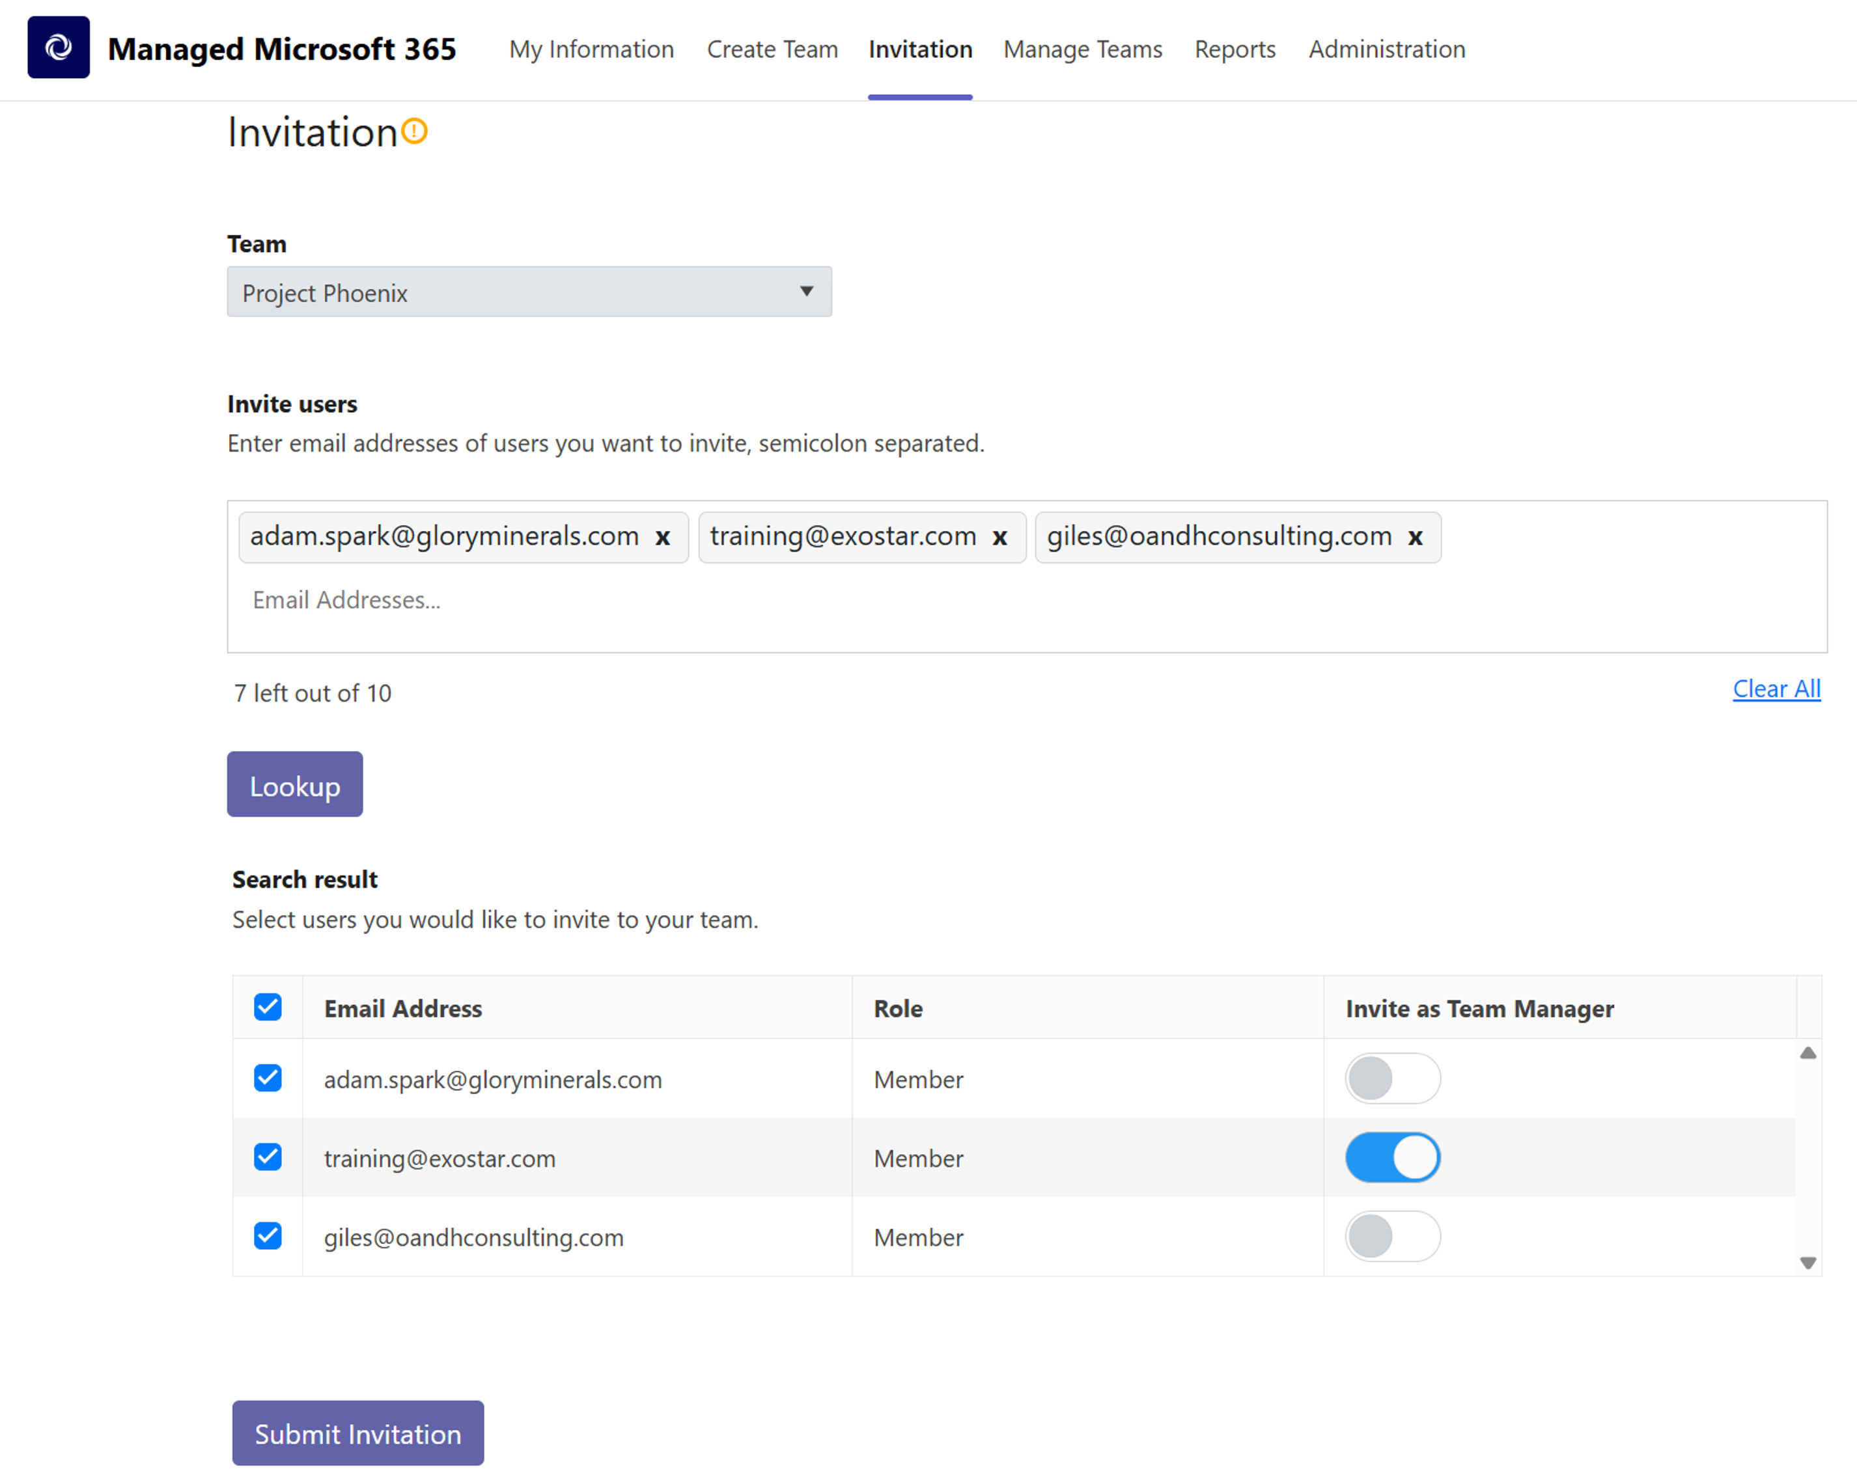
Administration: Authorized Domain / Multiple Domains
Invitation tab
1
Select Team from drop-down
2
Enter user’s emails and Lookup
3
Checkmark next to user’s
4
Submit Invitation
5
2026

Slide 23
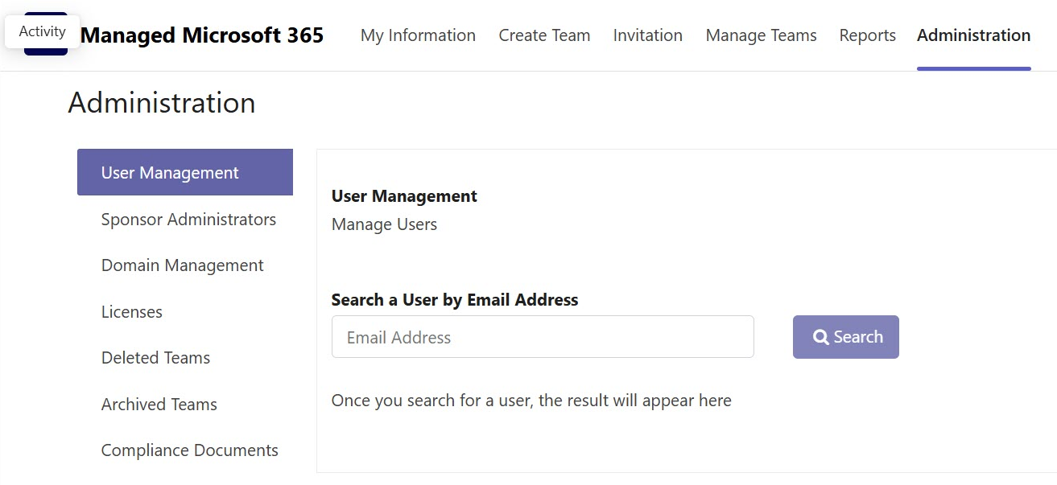
Administration: User Management
2
User Management tab
1
Administration Tab
3
Enter User’s Email
4
Click Search
Note: If the user exists, the user details will display.
2026

Slide 24
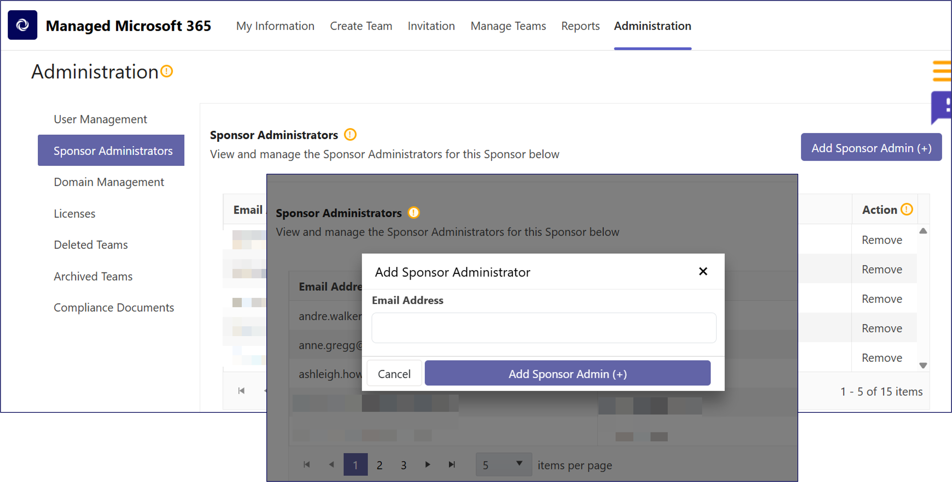
Administration: Sponsor Administration
1
Administration tab
2
Sponsor Administrators sub-tab
3
Add Sponsor Admin
4
Enter Email address
5
Add Sponsor Admin (+)
2026

Slide 25
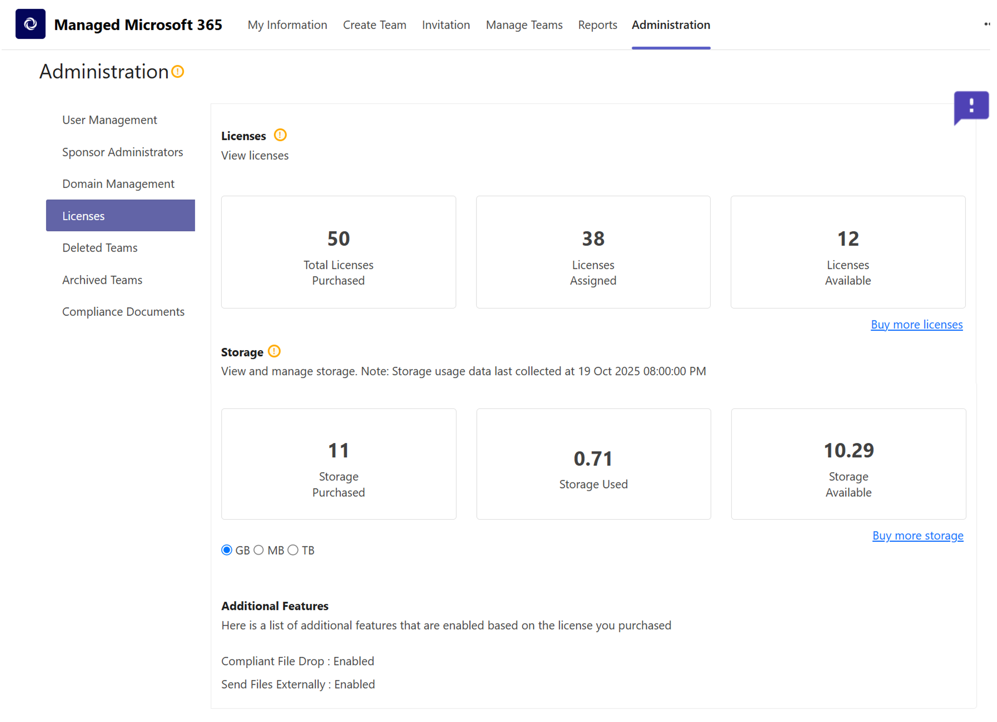
Administration: Licenses
Administration tab
1
Licenses sub-tab
2
Storage
3
Additional Features
4
2026

Slide 26
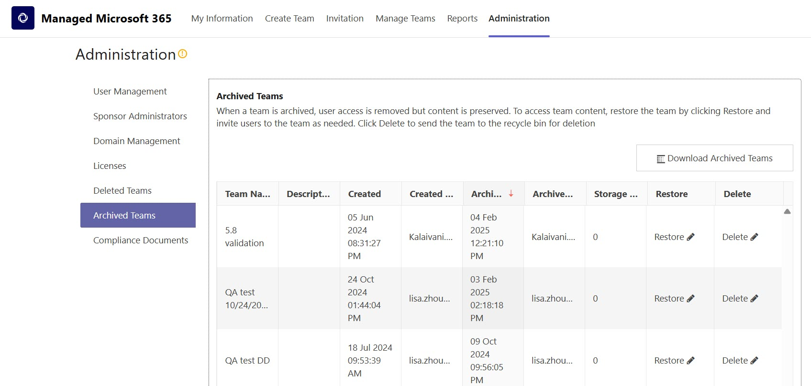
Administration: Archived Teams
Administration tab
Download file
Archived Teams sub-tab
2026

Slide 27
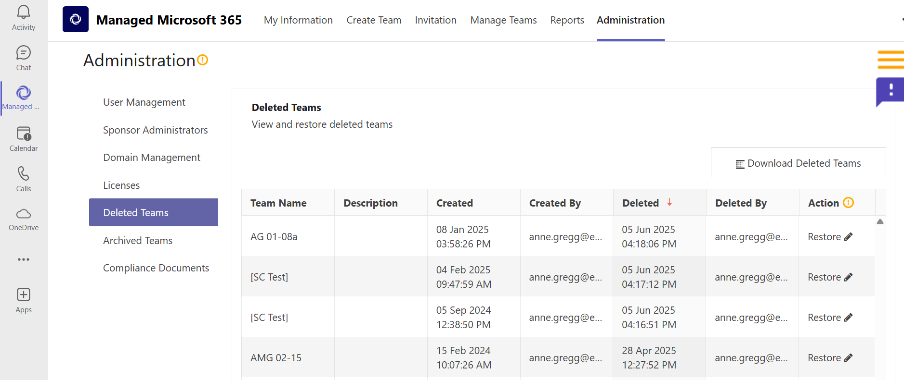
Administration: Deleted Teams
2
Deleted Teams sub-tab
1
Administration tab
3
Download Report
4
Restore
2026

Slide 28
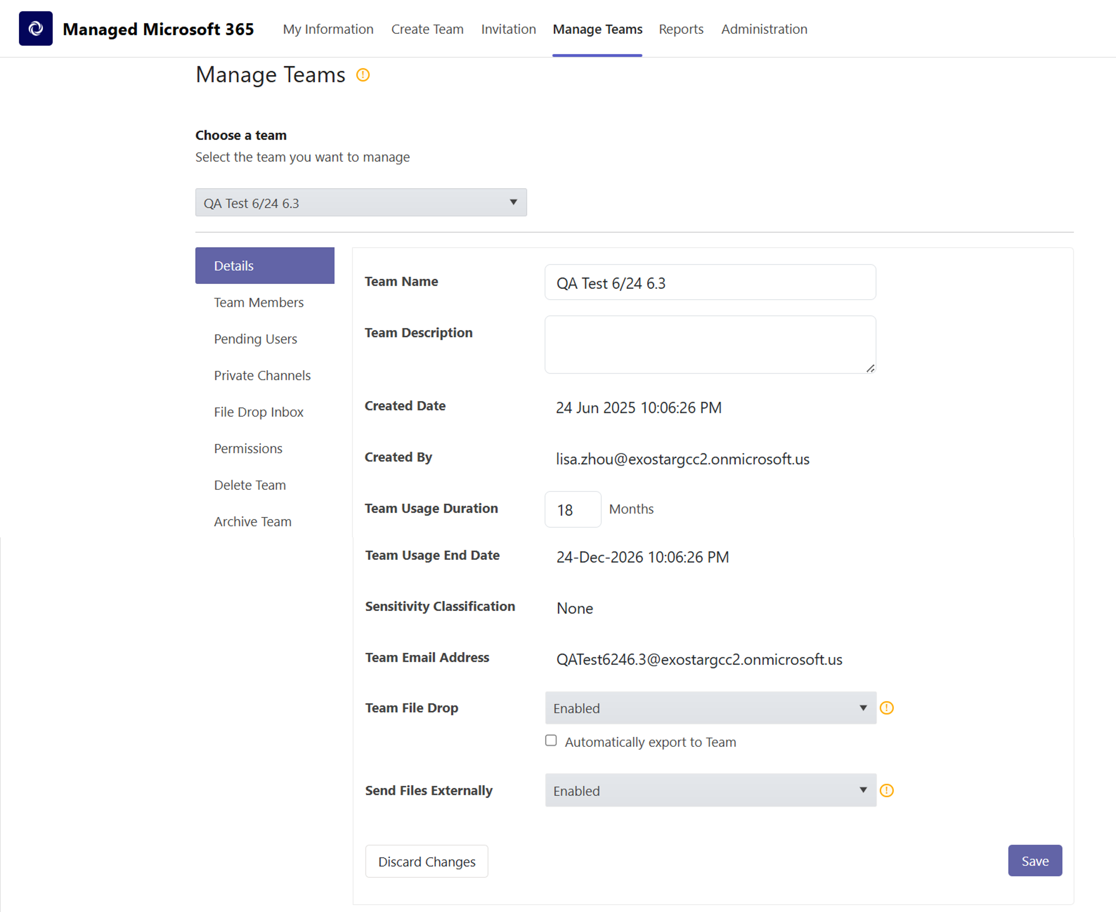
Manage Teams tab
Manage Teams tab
1
Choose a Team drop-down
2
3
Details sub-tab
NOTE: A team email address is created during the team creation process
Update Team name, description, duration
4
Enable file drop and send files externally
5
2026

Slide 29
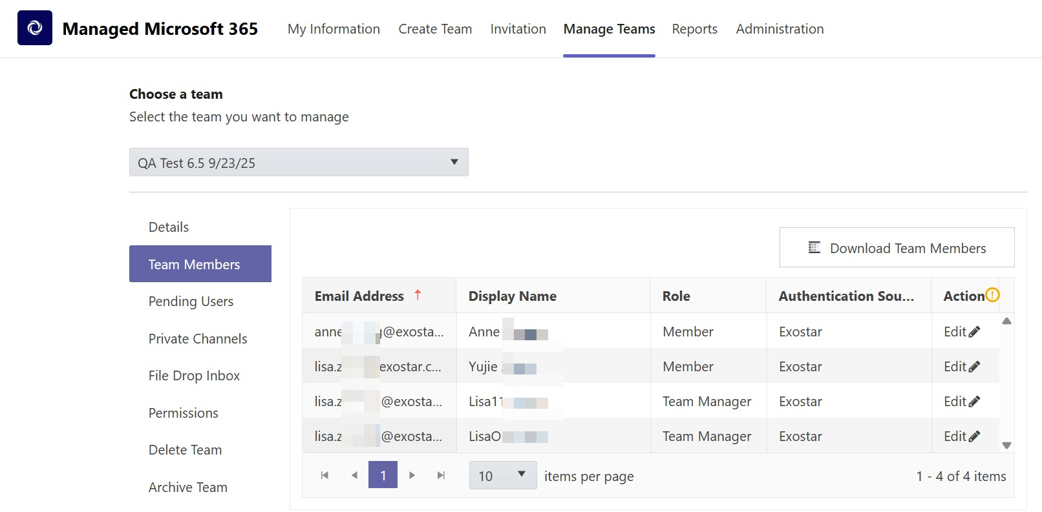
Manage Teams: Team Members
Choose a Team
Manage Teams tab
Download Team Members
Team Members sub-tab
2026

Slide 30
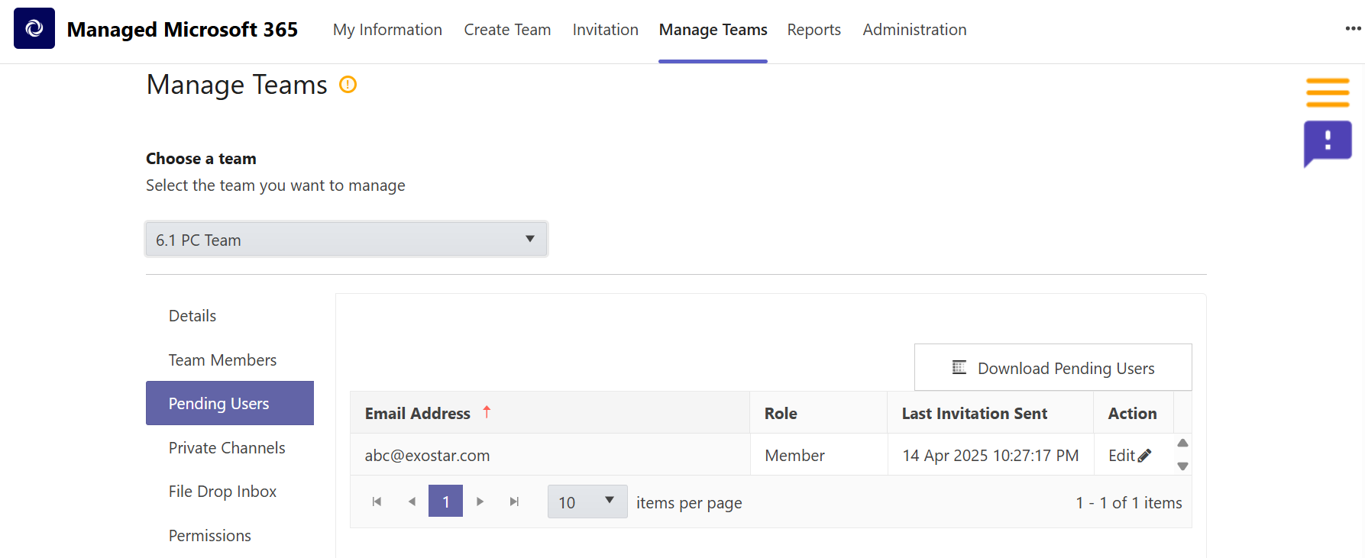
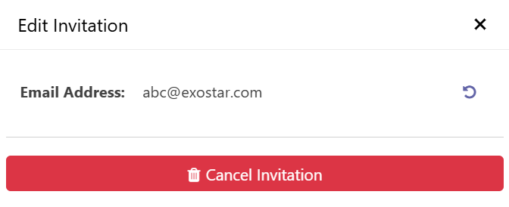
Managed Teams: Pending Users
1
Manage Teams tab
2
Choose a Team drop-down
3
Pending Users sub-tab
4
Download Pending Users
5
Edit Invite
2026

Slide 31
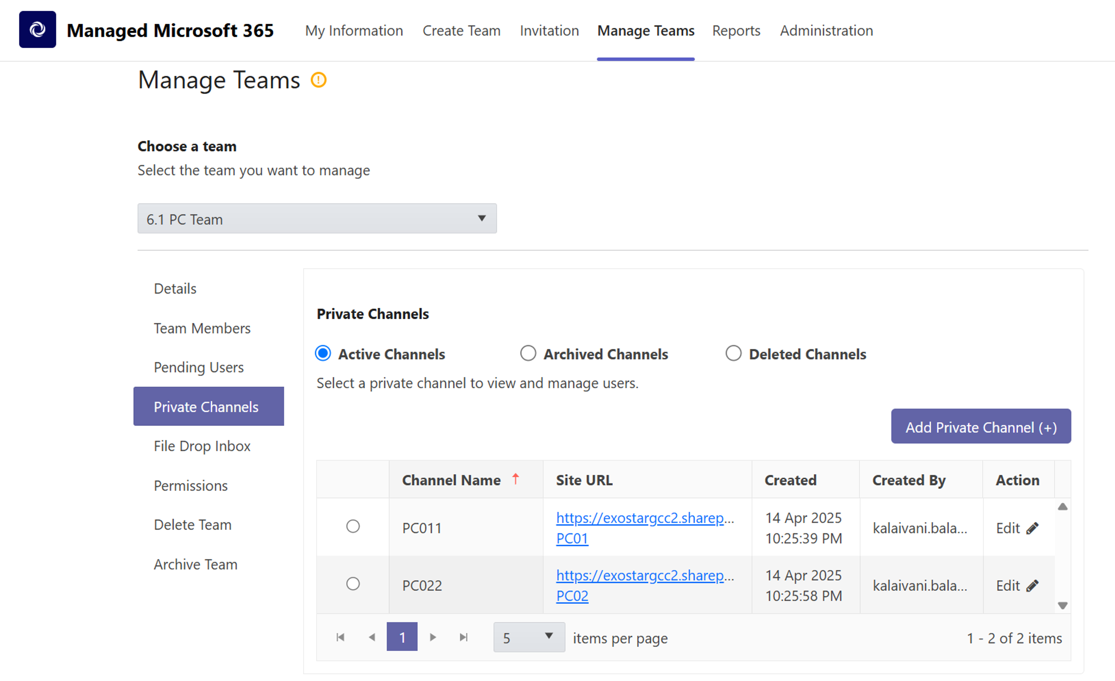
Manage Teams: Private Channels
Manage Teams tab
1
Choose a team drop-down
2
Private Channels sub-tab
3
Add Private Channel
4
View/edit channel team members
5
2026

Slide 32
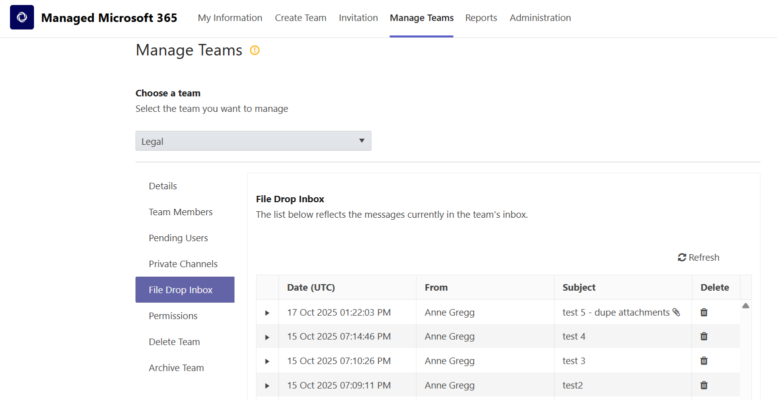
Manage Teams: File Drop Inbox
Manage Teams tab
Choose a Team
File Drop Inbox
2026

Slide 33
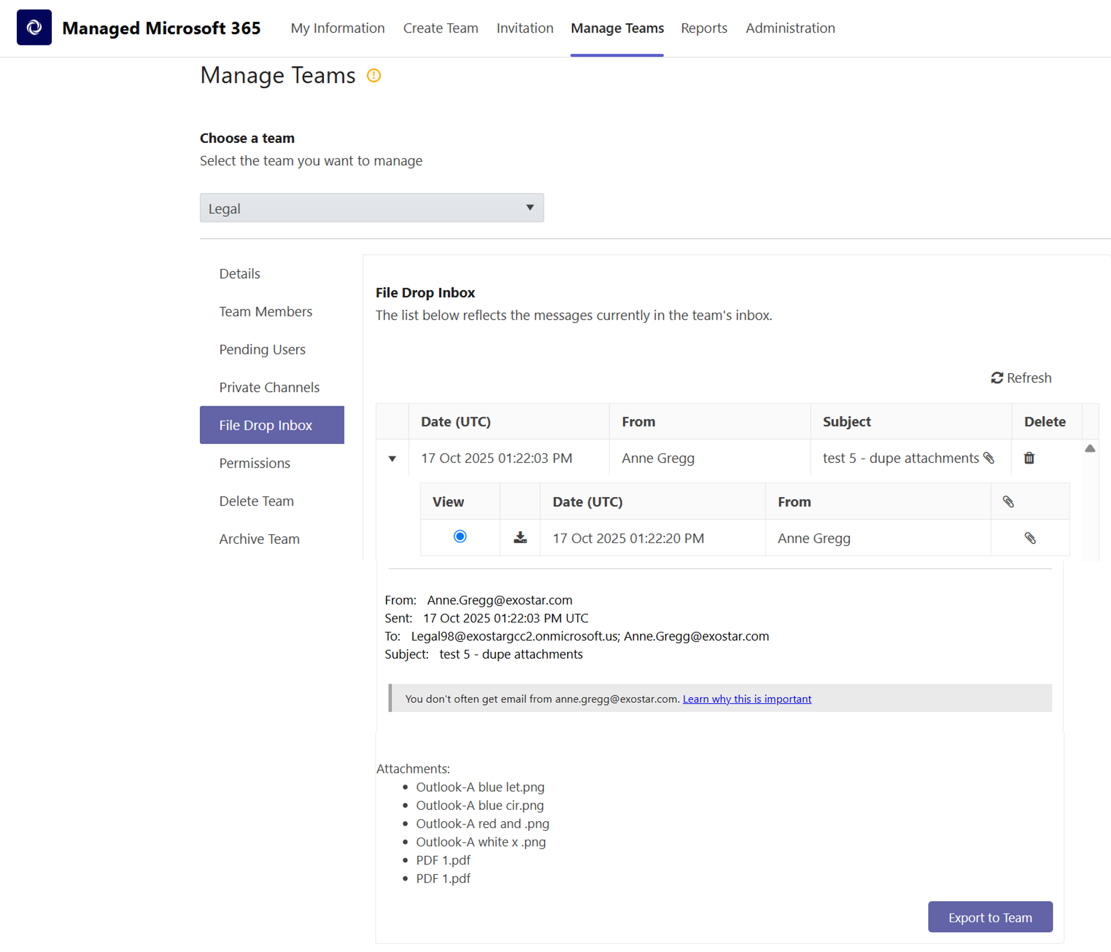
File Drop Inbox - View Message
Manage Teams tab
1
Choose a Team
2
File Drop Inbox
3
View Message
4
Export Message & Attachments
5
2026

Slide 34
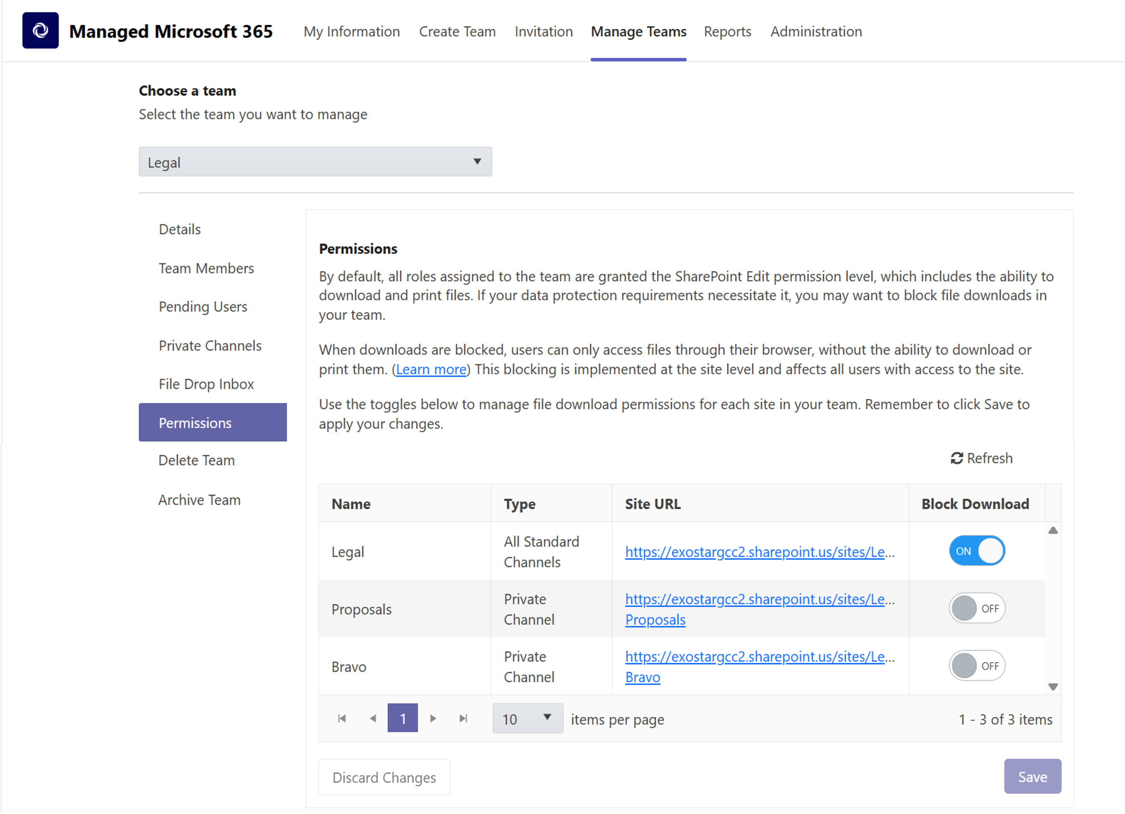
Manage Teams: Permissions
Permissions tab
Block files from being downloaded or printed.
Only allow users to view files in their browser.
Turn ON/OFF to enable.
Click Save for any changes.
2026

Slide 35
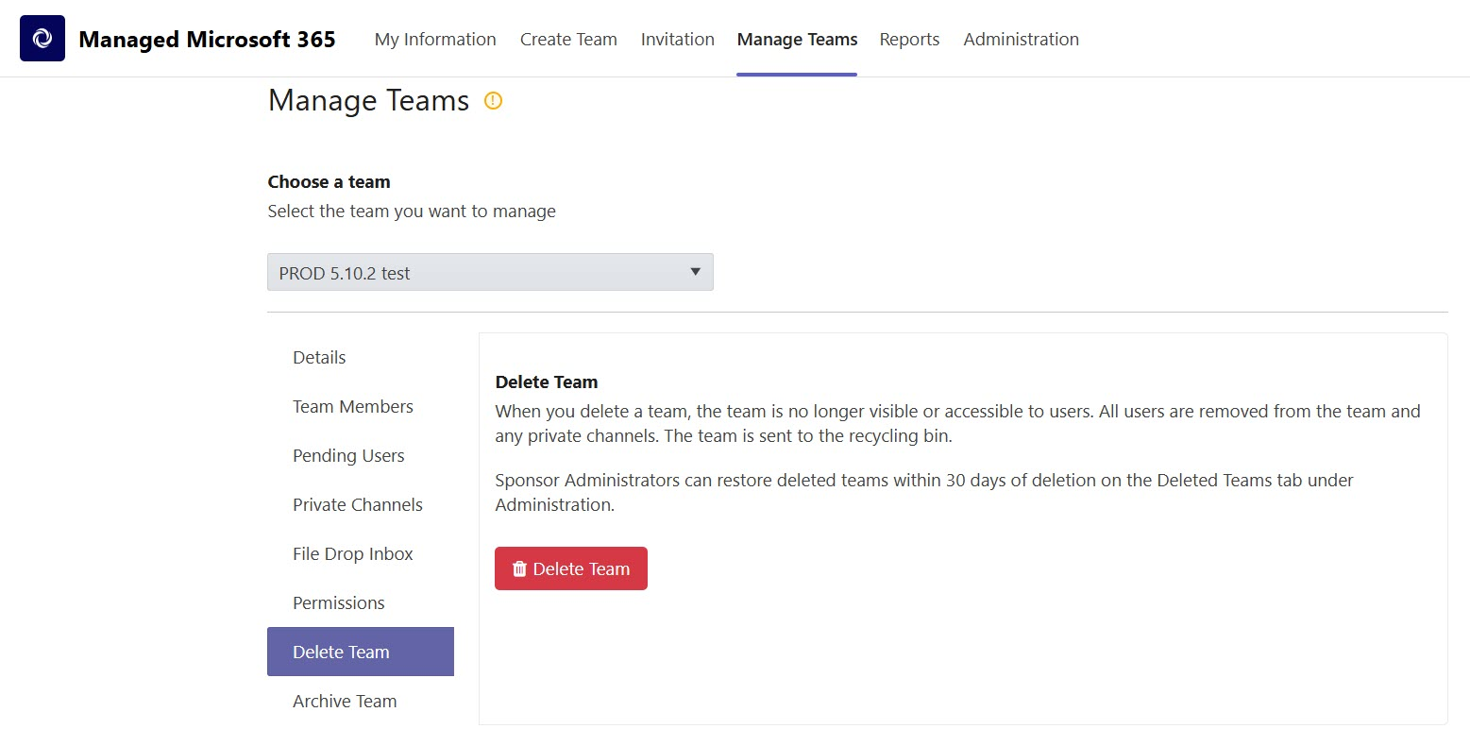
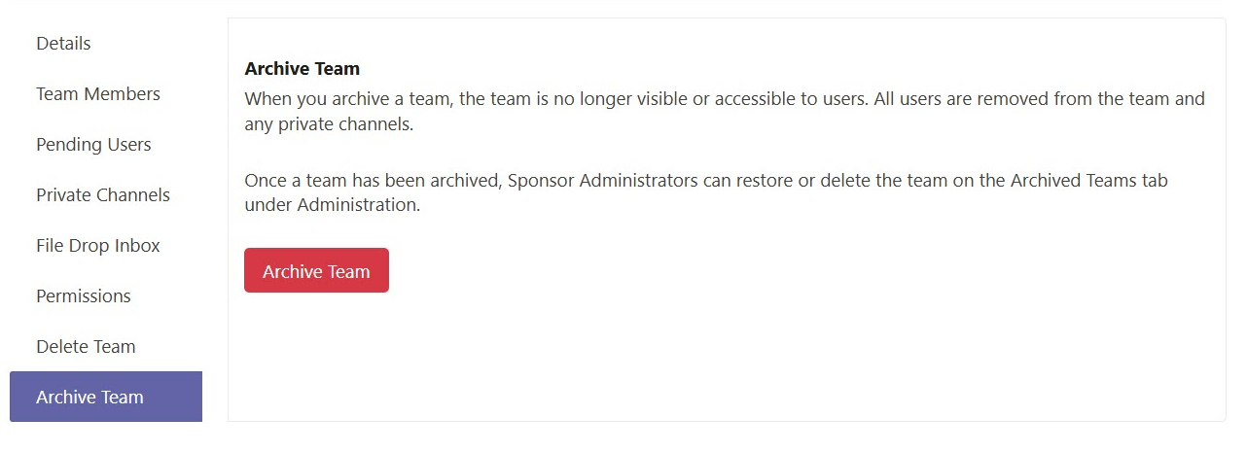
Manage Teams: Delete/Archive Team
Choose a Team
Delete or Archive team
Deleted/Archived teams will show in Administration tab
2026

Slide 36
Send Files Externally
2026

Slide 37
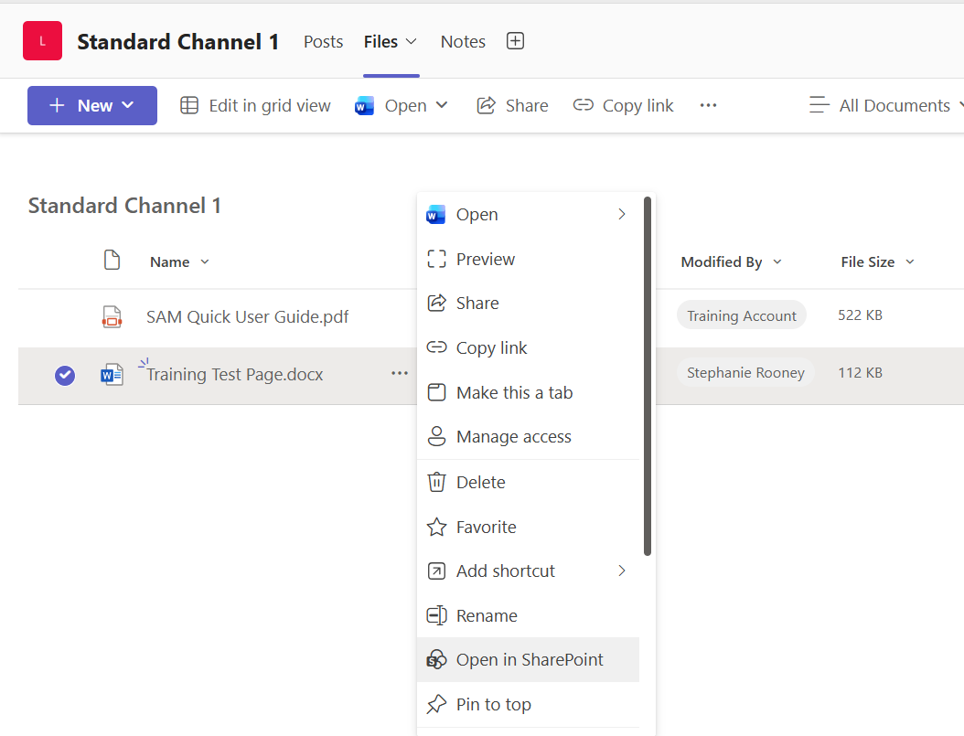
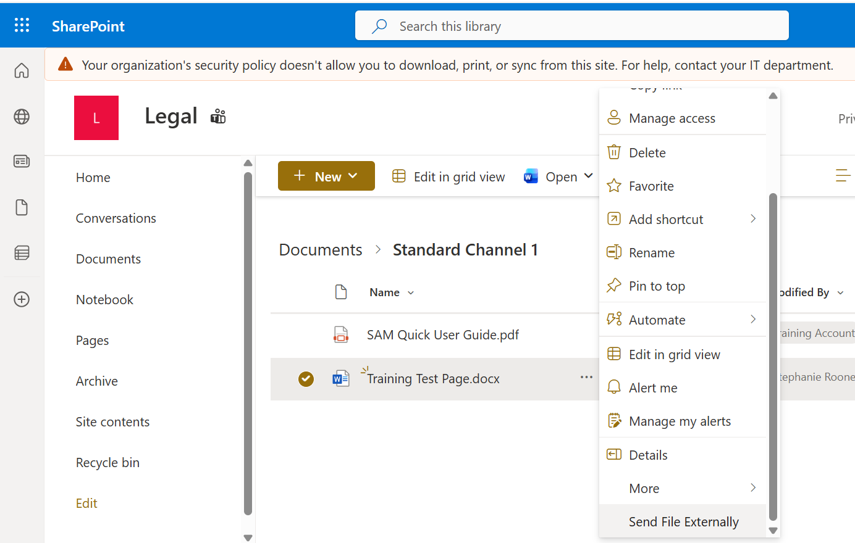
Manage Teams: Send Files Externally
1
2
3
4
5
2026

Slide 38
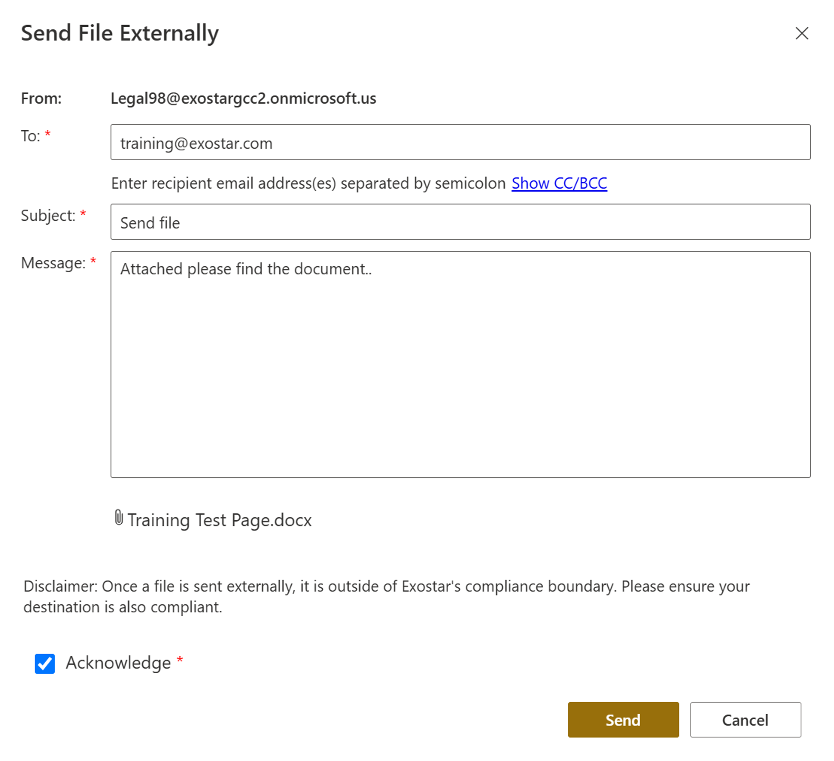
Manage Teams: Send Files Externally
Fill out required fields.
Make sure attachment is attached.
Check Acknowledge*
Click Send
Maximum File Size:
2MB (GCC-H)
30MB (Commercial)
2026

Slide 39
Reports
2026

Slide 40
Reports
Report Name | Description
Audit Report (Exostar App Actions) | Reports all actions that occur within the Exostar custom Teams Application that are covered and exportable. (Must submit a ticket request for this report).
Licensed Users Report | Reports a list of users that have an associated license, which includes provisioned users, as well as pending users. (Shows who is using a license seat).
Pending Users Report | Reports a list of invited and pending users that don’t have a MAG account. Also shows which team they were invited to and invitation date.
SharePoint Audit Report | Reports detailed audit logs for user activities and monitoring of CUI meets CMMC compliance and regulation standards.
Teams Report | Reports the number of teams, members and storage usage. (Shows how much storage is being utilized per team).
Users Report | Reports detailed logs of each team, team members, and roles. (Shows if a user is part of multiple teams).
2026

Slide 41
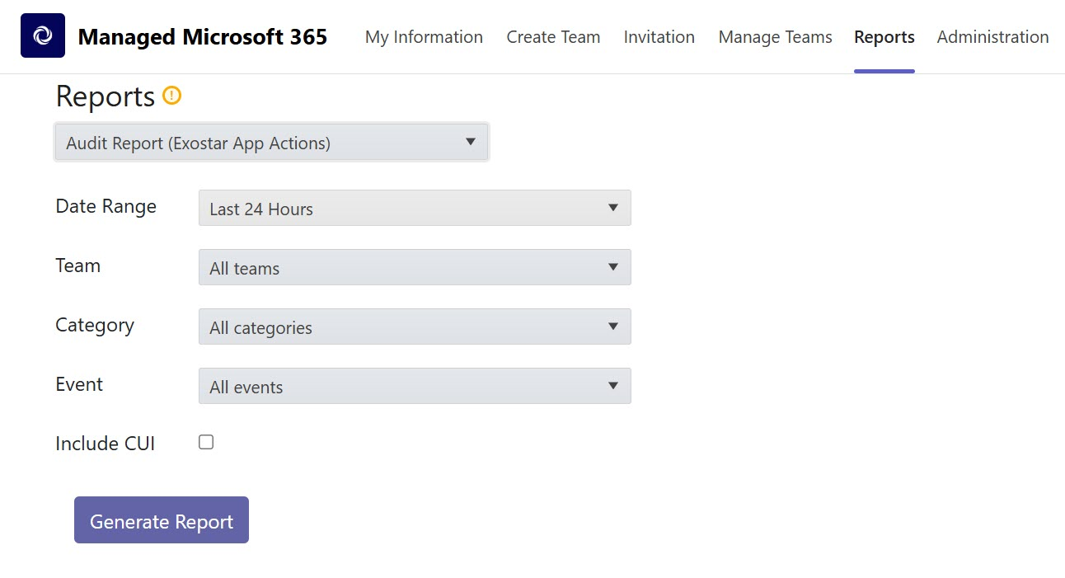
Reports: Audit Report (Exostar Actions)
1
Reports tab
2
Select Report drop-down
2
3
Choose Parameters
4
Generate Report
2026

Slide 42
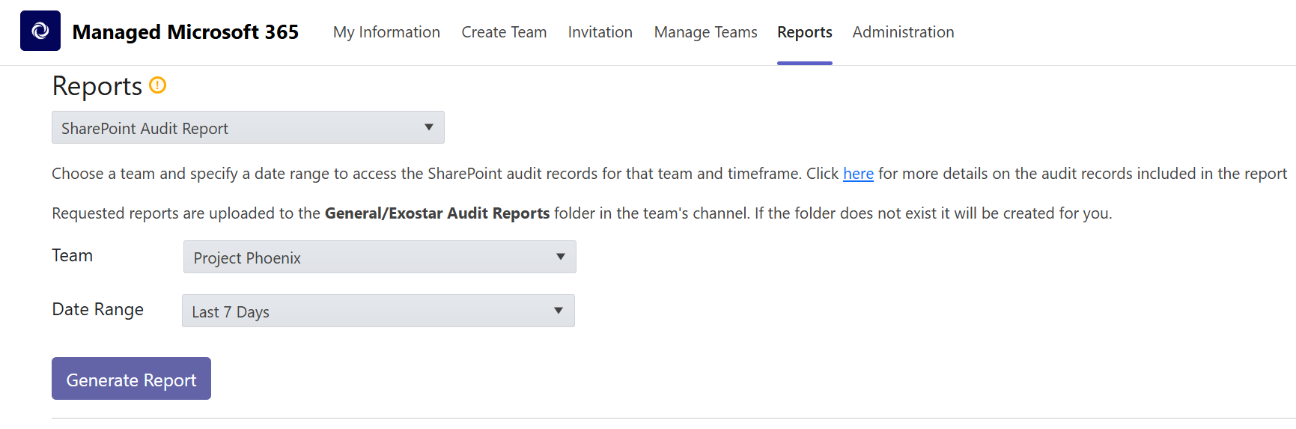
Reports: SharePoint Audit Report
2026

Slide 43
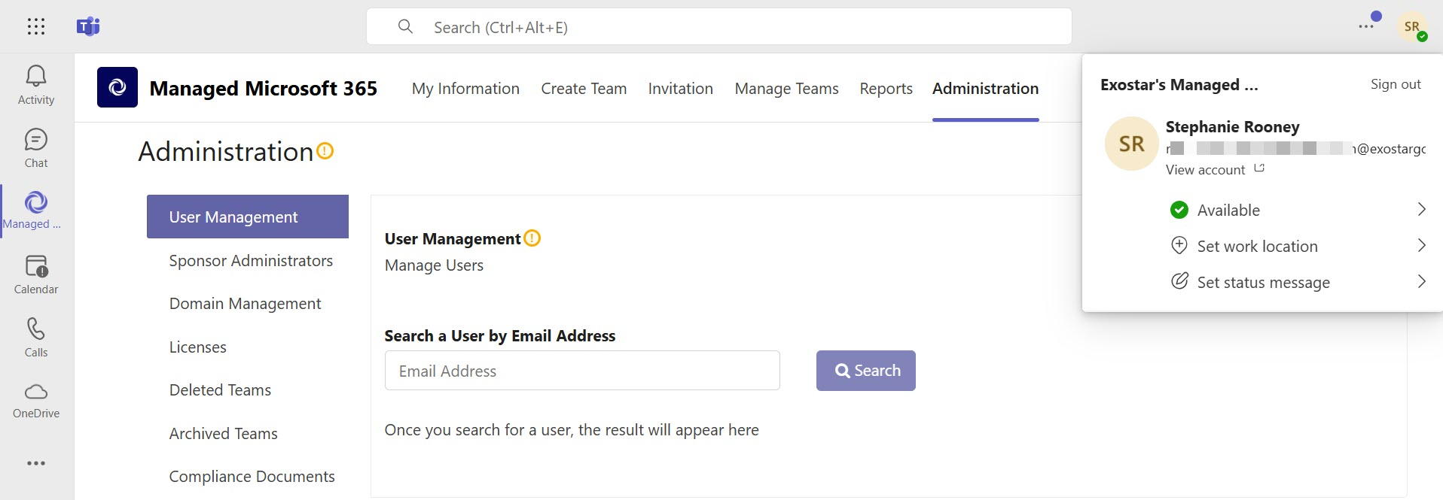
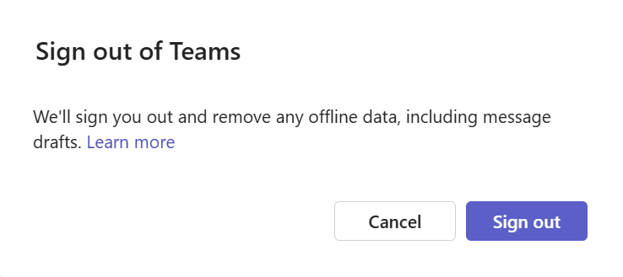
Exostar Application Sign Out
1
Click your Initials
2
Select Sign out
3
Click Sign out again
2026

Slide 44
MyExostar: Self-help
2026

Slide 45
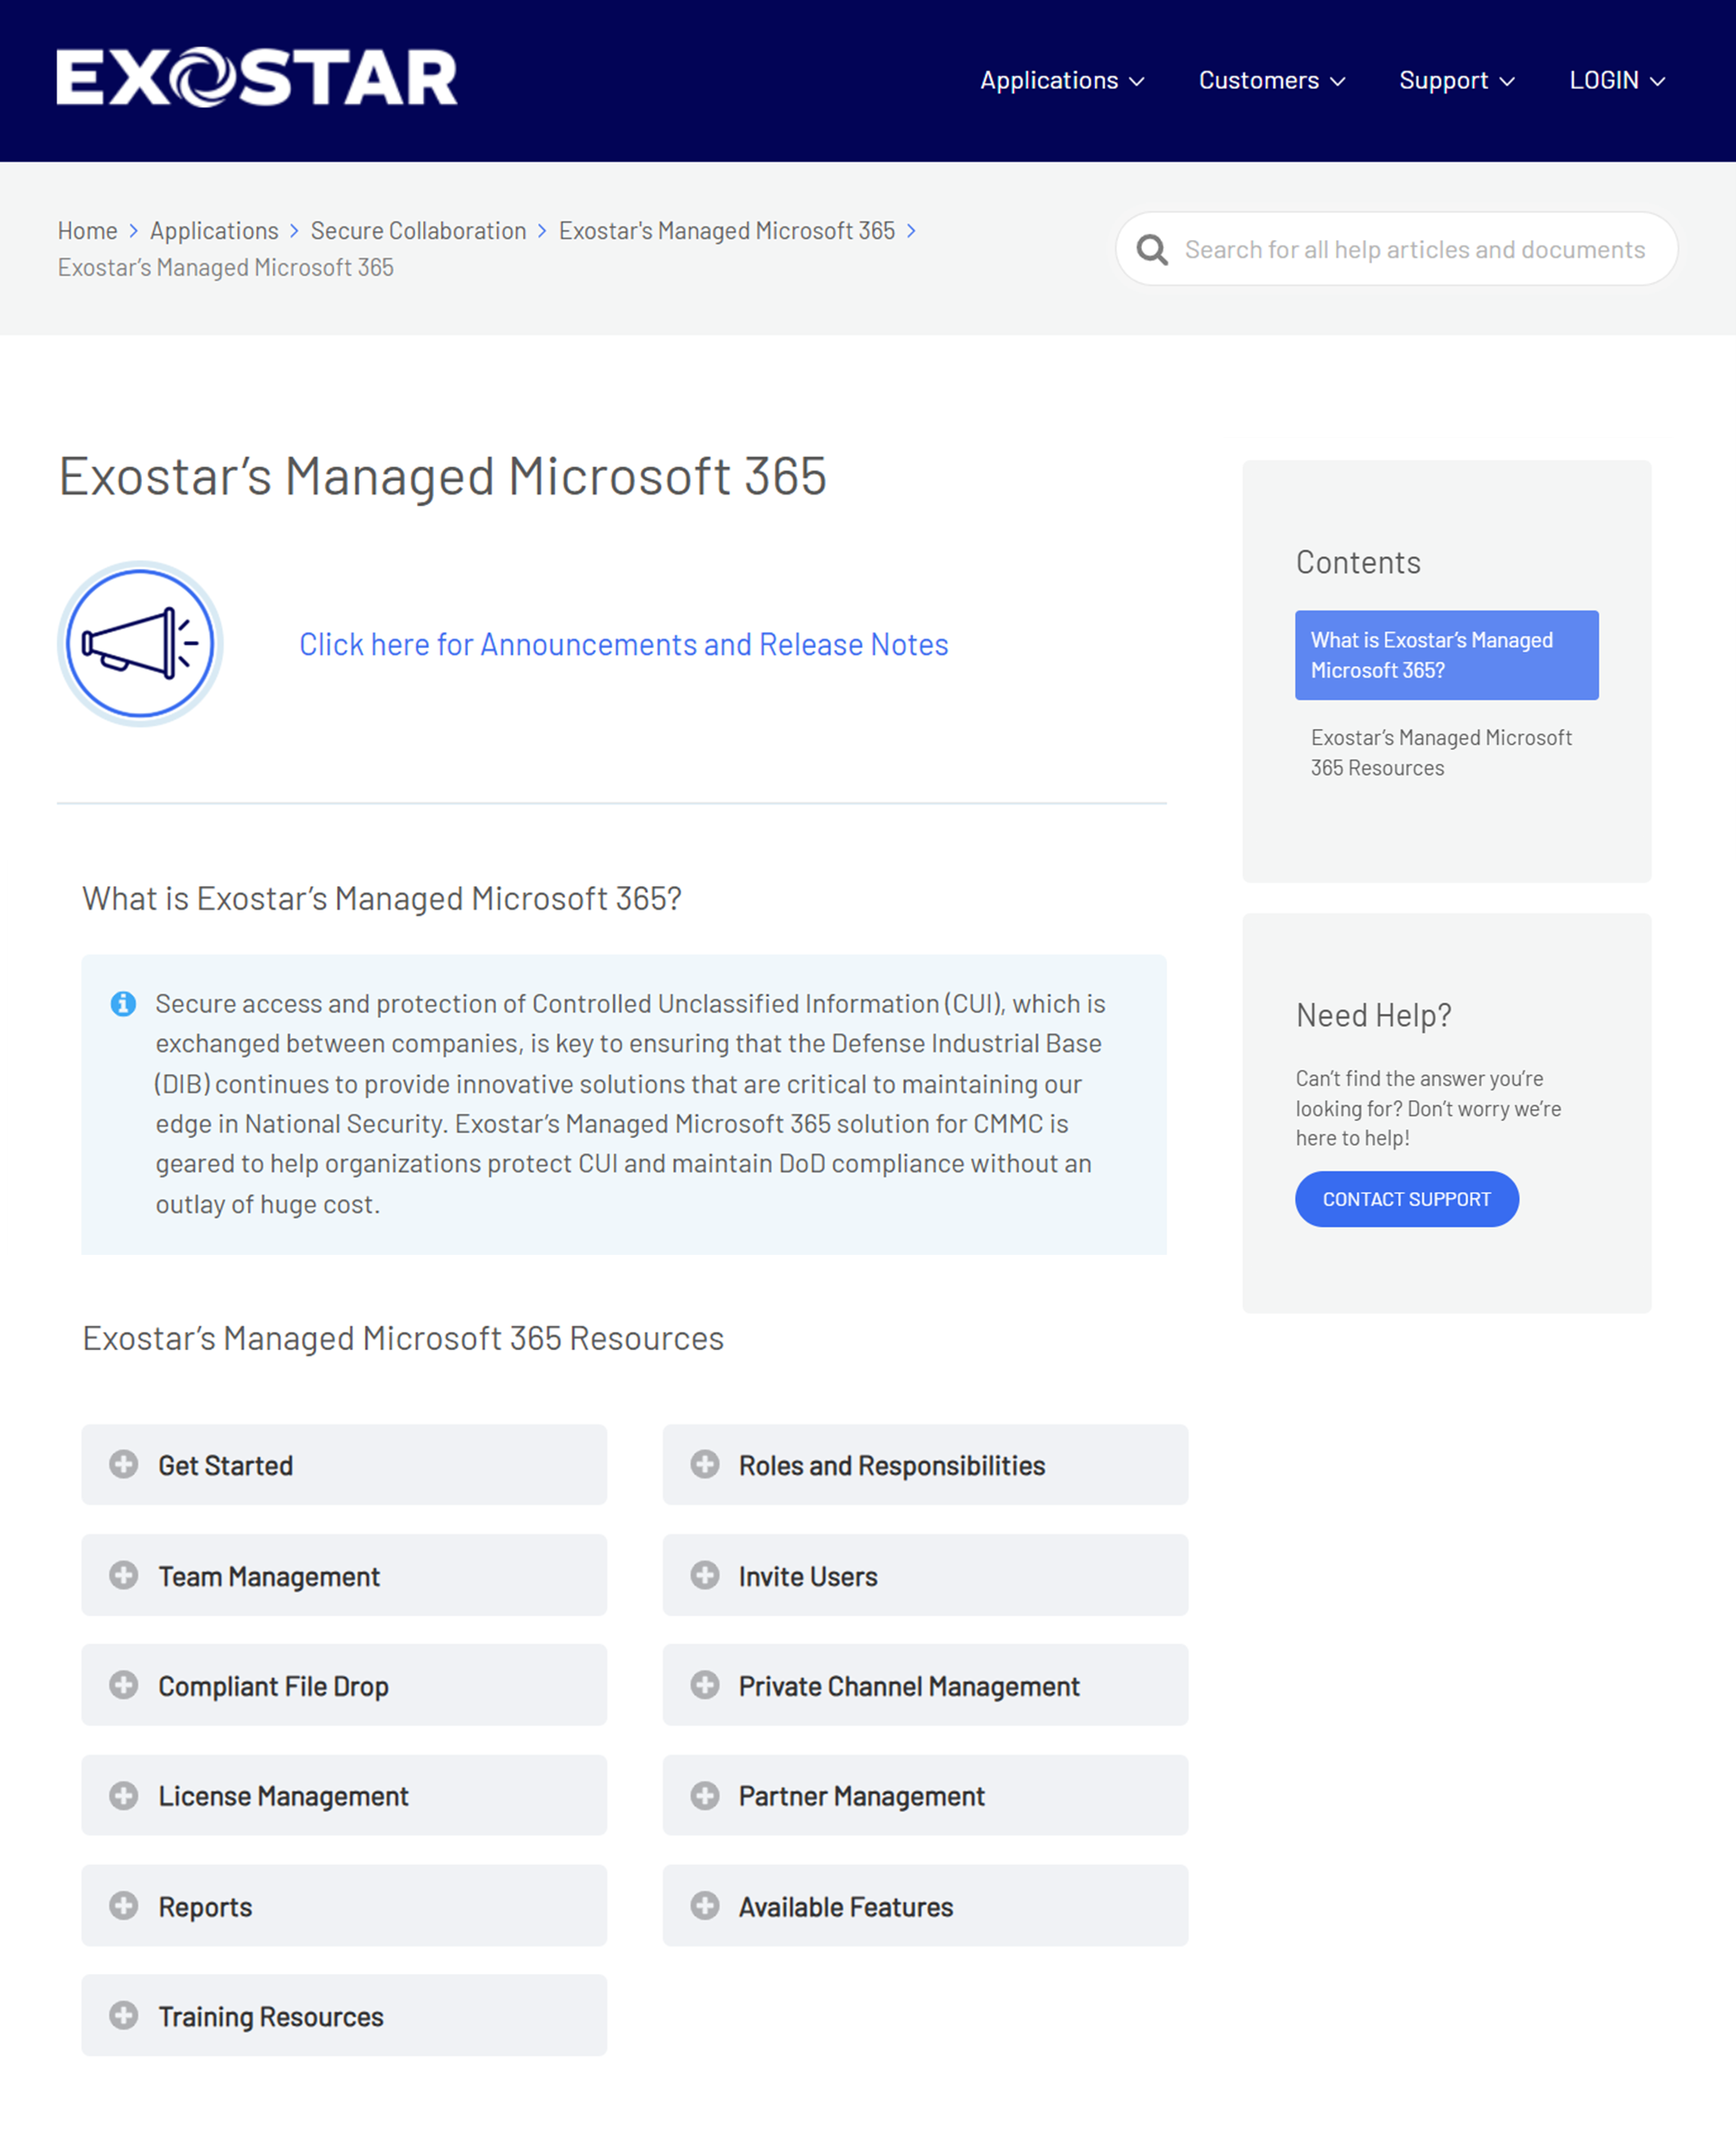
Self-help: MyExostar.com
Exostar’s Managed Microsoft 365 overview
Exostar’s Managed Microsoft 365 Get Started
Exostar’s Managed Microsoft 365 Training Resources
Need help? Contact Support
Questions or comments? Emails us at training@exostar.com
2026

